Slide 1

SA Presentation
notReal - Bee Brawler: Exit the Hive

Slide 2
Table of Contents
Brief Introduction
Storyboard
Introduction to Game
Context Diagram
Data Flow Diagram
Global Use Case
Individual Features
Notes:
Dawson

Slide 3
Team Leads
TL1 - Dawson Burgess
TL2 - Spencer Butler, Jacob Wobido
TL3 - Liam Mathews
TL4 - Nyah Nelson
TL5 - Jackson Baldwin
TL6 - Bryan Frahm
Notes:
Everyone introduces themselves

Slide 4
Brief Introduction
What is our game?
A 2D side scrolling roguelike
A roguelike is ___
It involves Bees, wasps, other surprise insects and animals, and a revolutionary game story.
What is the Goal?
The goal of our game is to “exit the hive” and defeat all the enemies on the way. This will save the queen, and the hive as a whole.
Notes:
Jackson

Slide 5
Storyboard

Slide 6



1
rouge-like
Save us!
The player will be spawned in the center of the hive, in the queens chambers. She will explain the hive has been attacked and the player needs to save it!
Dialogue
“Our beloved hive is under attack, <player_name> I need your help to save it! I task you with clearing the hive and pushing through to the exit.”
Notes:
Dawson

Slide 7
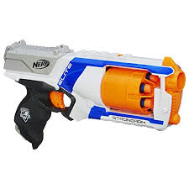
2
The player will progress to the first “room” of the game and presented with their first weapon. This will be the basic starting weapon, players can acquire new ones later.
Action
Player gets their first weapon.
Player is prompted open inventory and
see/equip the new weapon.
Notes:
Dawson

Slide 8



3
The player will be confronted with their first combat encounter with enemies. This will be room where to move onto the next, you must defeat all enemies. Later in the game this will be a survive a certain time room.
Action
Player fights their first set of enemies, they will be from the “easy” category.
Notes:
Bryan

Slide 9


4
One of the rooms the player can/will enter is a treasure room. There is no enemies to fight, but lots of “honey” (honey = money in our game) and experience.
Action
Player loots the treasure room and continues to the next area.
Notes:
Bryan

Slide 10


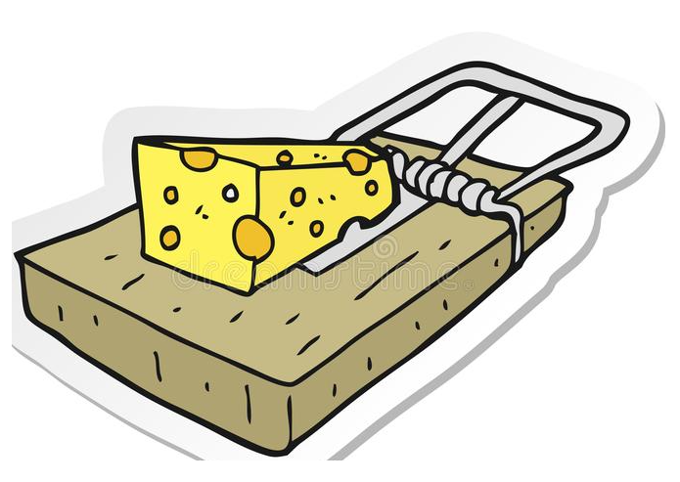
7
The player enters a “trap” room, which is where they will need to navigate around various traps and fight enemies to progress.
Action
Player navigates through the trap room, fighting enemies if there are any.
Notes:
Spencer

Slide 11
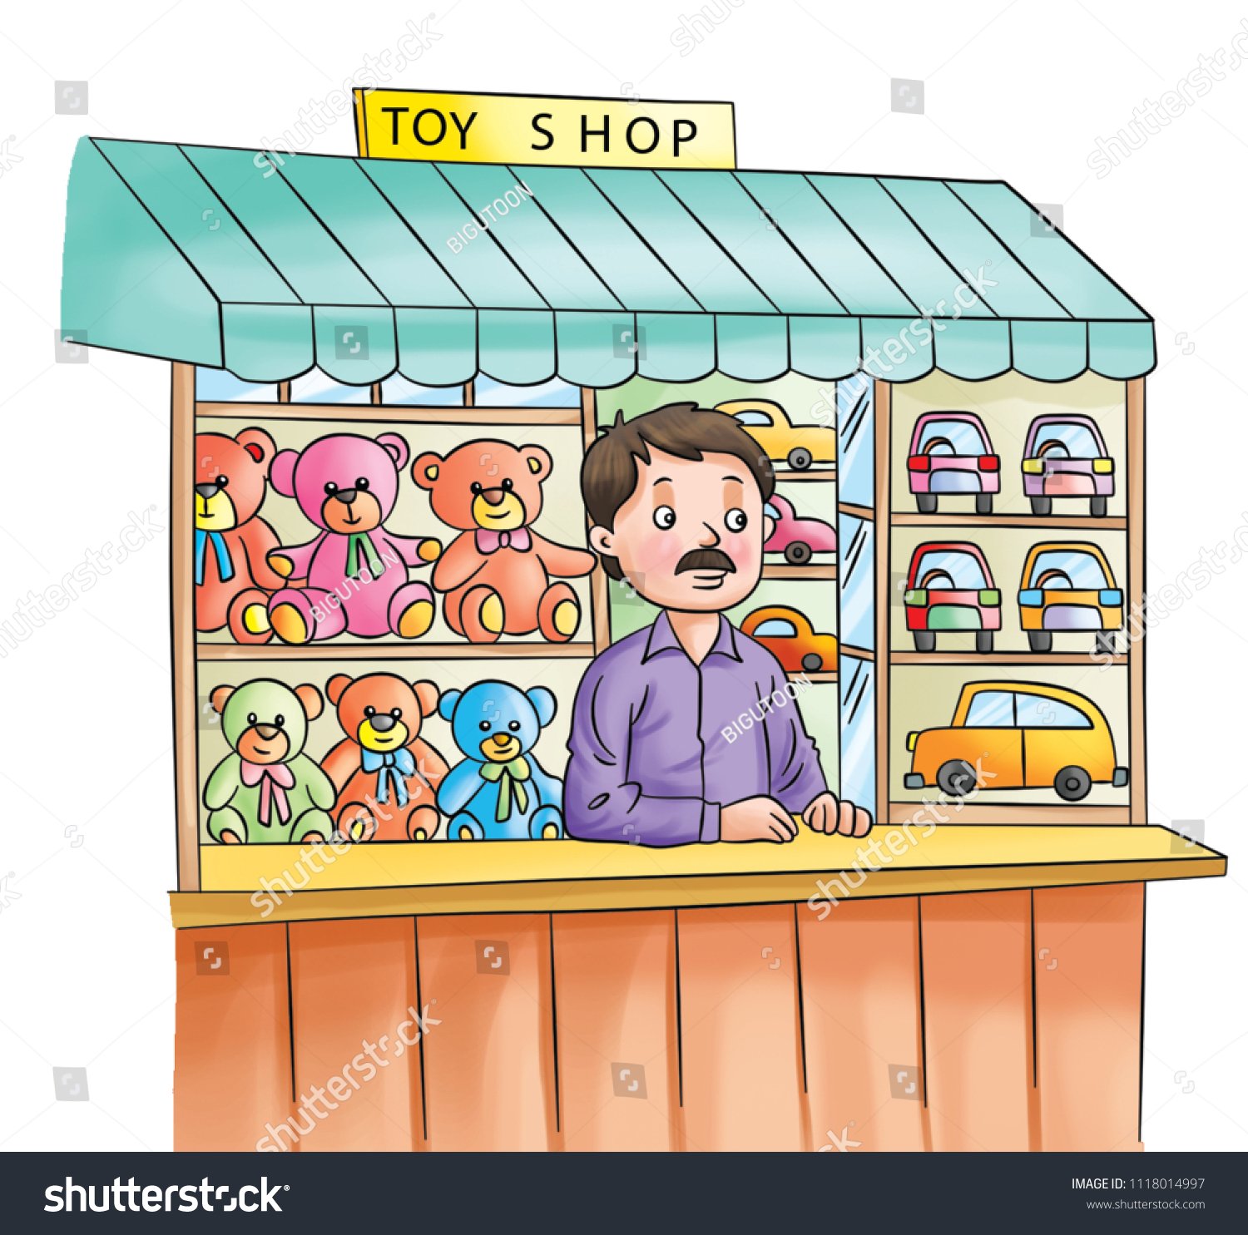
5
Take a look at my wares
Player will encounter a room that is dedicated to a shopkeeper. The shop keeper will talk to the player and then give the player the option to purchase health restores, upgrades, and other items.
Dialogue
“Hello warrior, need a boost to keep the upper hand? You should take a look at my wares.”
Notes:
Spencer

Slide 12
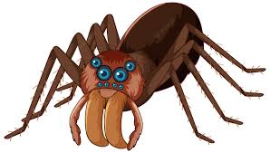

6
At some point during the players progression through the rooms, the player will encounter their first set of “elite” enemies. This will be similar to a boss encounter, and will have unique attacks with buffed stats.
Action
Player must defeat their first set of elite enemies to move onto the next room.
Notes:
Spencer

Slide 13


8
The player reaches the exit of the hive, and is confronted with a final boss to beat the game and save the hive.
Action
Player must fight the final boss of the game.
Then the game ends…..
Notes:
Liam

Slide 14
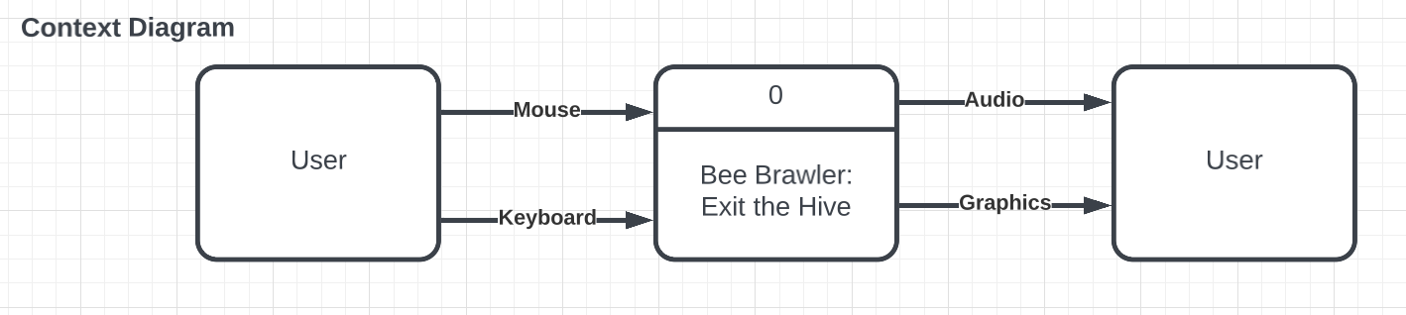
Introduction to the game - Context Diagram
Notes:
Nyah

Slide 15
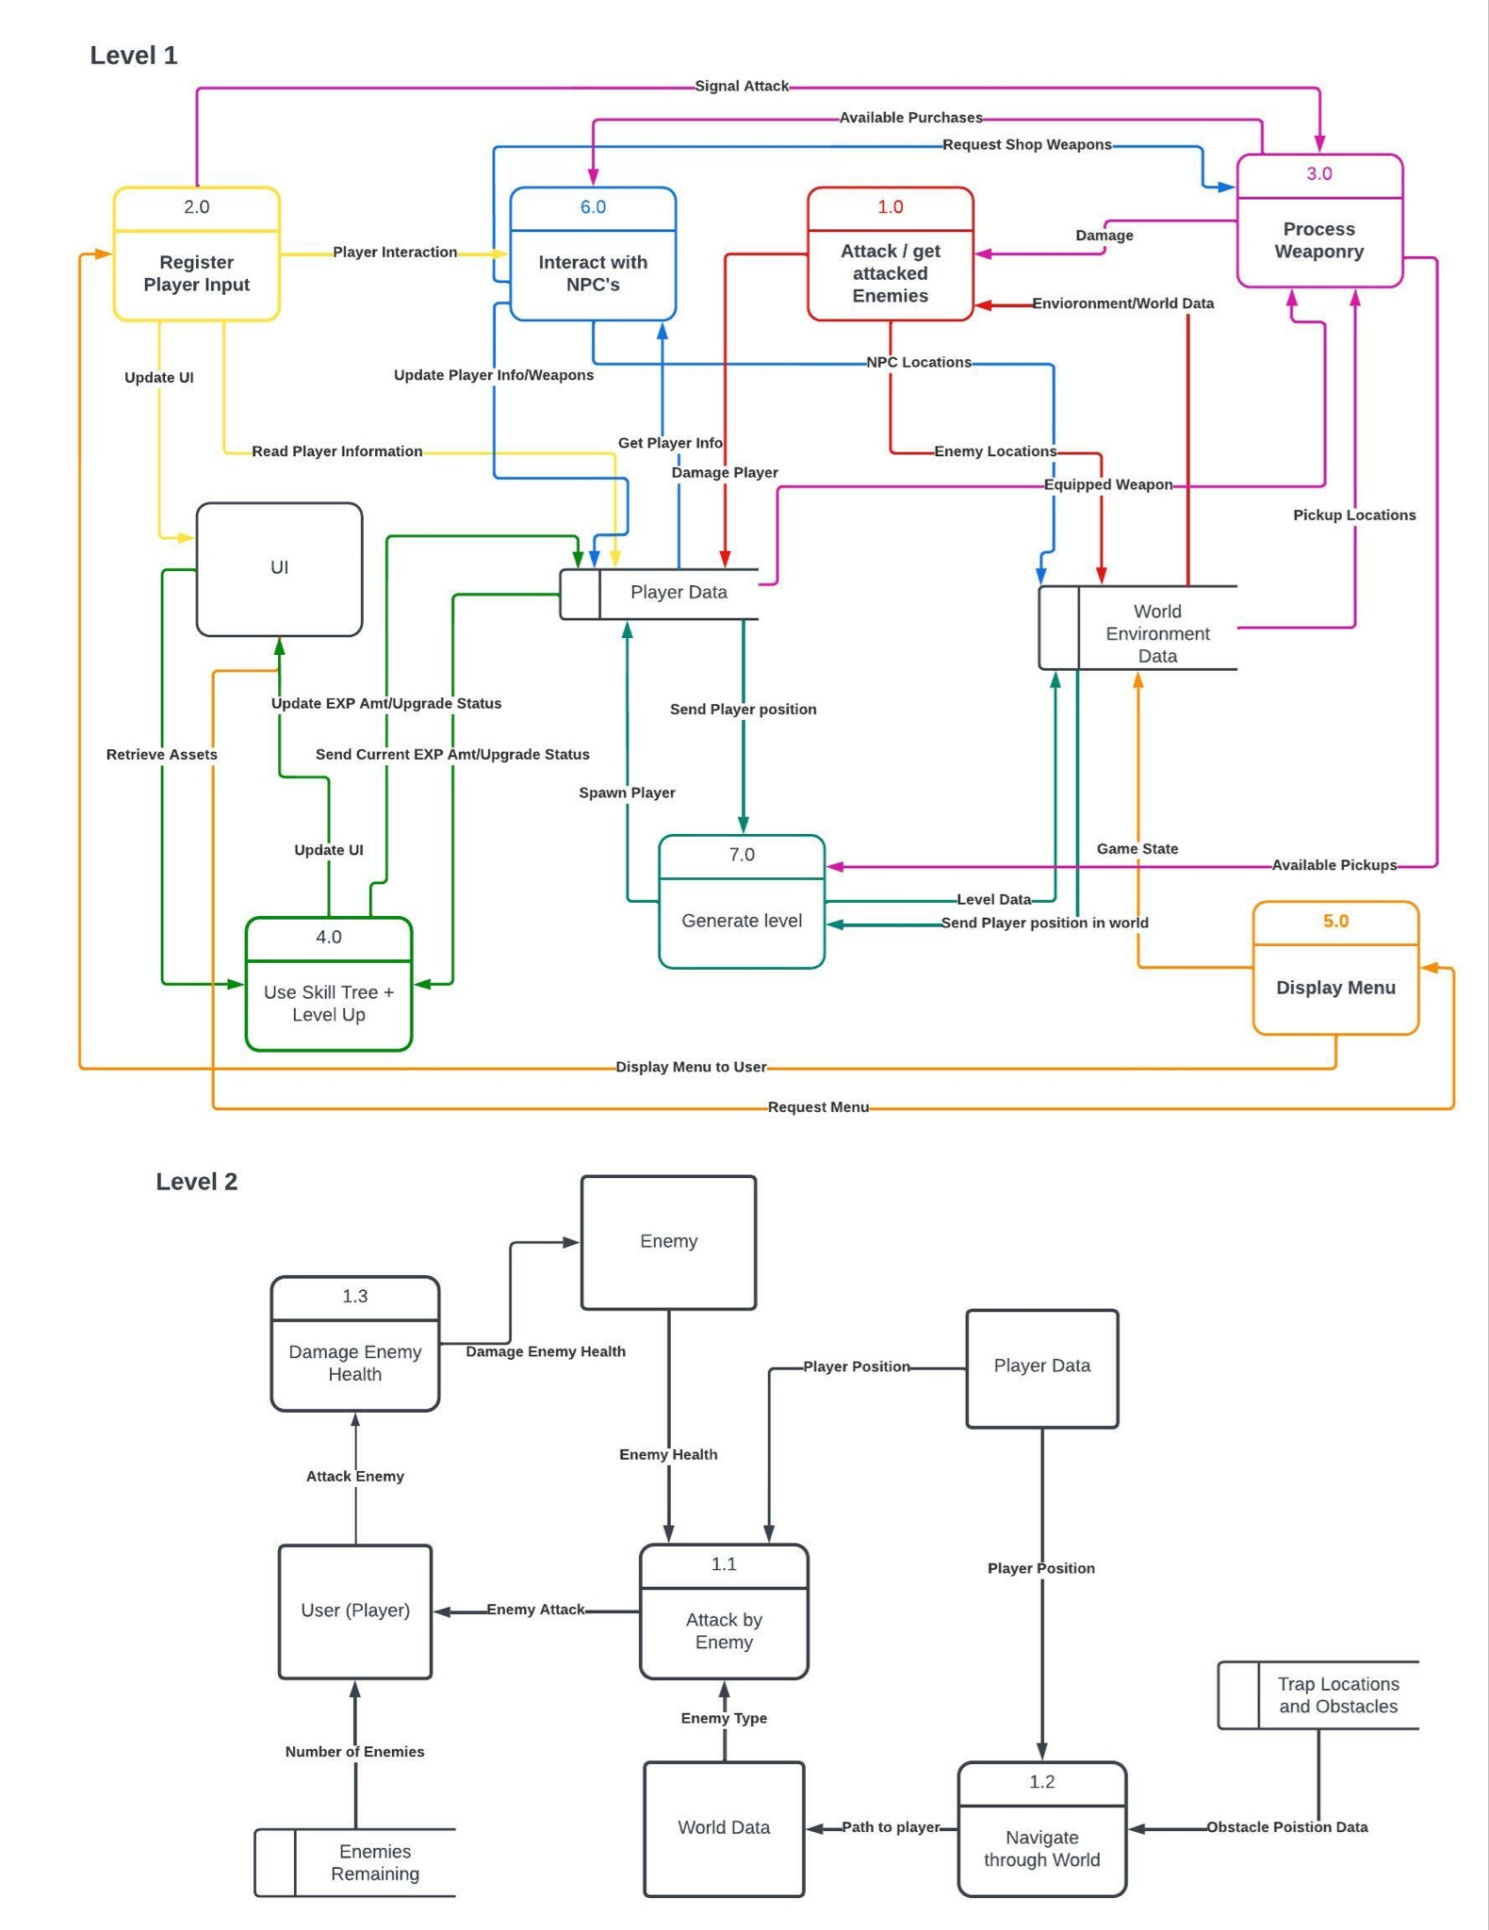
Introduction to the game - Data Flow Diagram 0
Notes:
Numerical ordering

Slide 16
Global Use Case

Slide 17
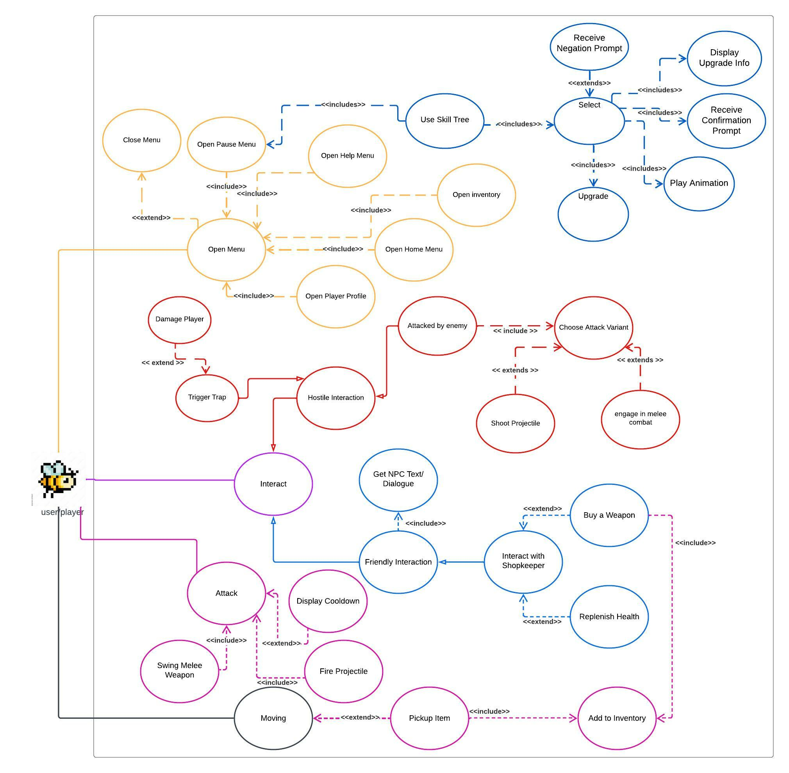
Notes:
Start at the player and what they can do, then walk through top to bottom, left to right

Slide 18
Individual Features

Slide 19
Team Lead 1 - Dawson Burgess

Slide 20
Enemies Overview - Dawson Burgess
Role
Creating a variety of enemies, which will be the most common interaction for the player to have in the game.
Priority = 1 (must have)
Since there is not much to do in our game besides fight enemies, and they are required to make progression through the game, enemies of some sorts are essential.
Complexity = Medium
There will be many types and difficulties of enemies, it will not become complex until the unique and elite enemy types are added. It will not be too difficult, but will take a large chunk of time.

Slide 21
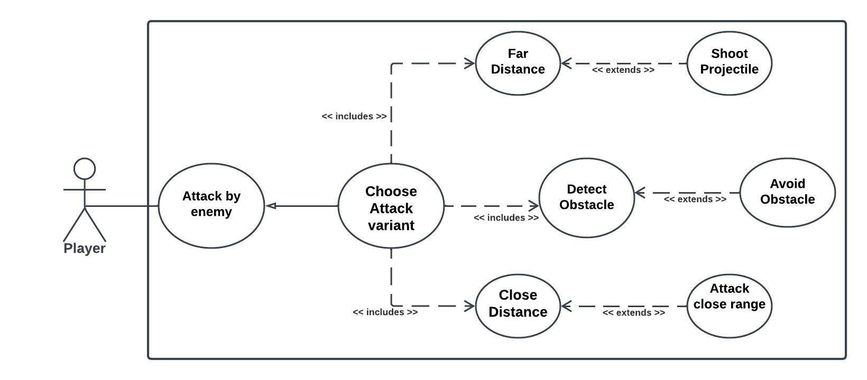
Enemy Use Case Diagram - Dawson Burgess

Slide 22
Team Lead 2 - Jacob Wobido

Slide 23
Player Movement Overview - Jacob Wobido
Role
Create the bee player, as well as implement its movement.
Priority = 1 (must have)
Player movement is not only essential to a roguelike, but allows games to stand out over others
Complexity = High

Slide 24
Player Movement Use Case Diagram - Jacob Wobido

Slide 25
Team Lead 2 - Spencer Butler

Slide 26
Weapons Overview - Spencer Butler
Display attacks and damage enemies
Priority: 2
Complexity: Medium

Slide 27
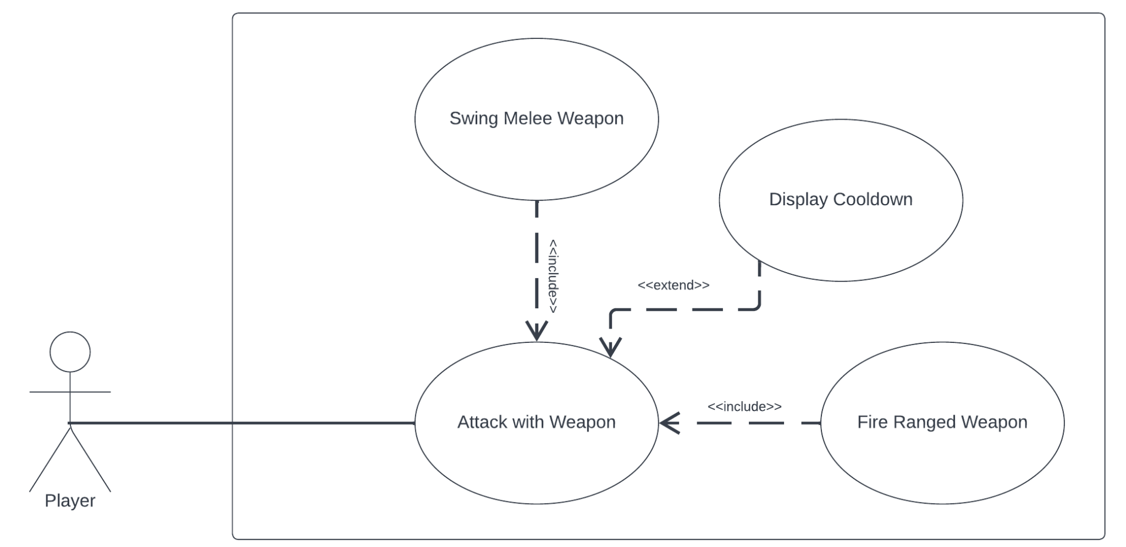
Weapons Use Case -- Spencer Butler

Slide 28
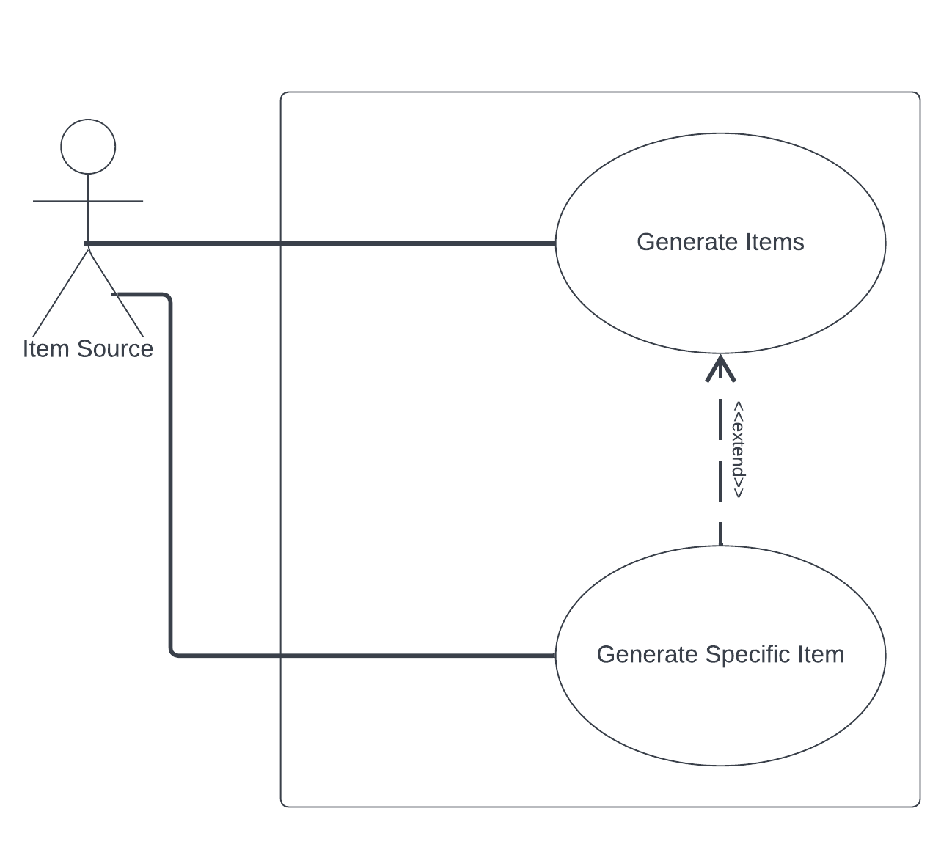
Weapons Use Case -- Spencer Butler

Slide 29
Team Lead 3 - Liam Mathews

Slide 30
Skill Tree Overview
What is a skill tree?
Leveling system that offers choice to the player when making their character more powerful.
Certain items, typically EXP, which are most often collected after defeating enemies, are exchanged as a kind of currency to “purchase” upgrades.
Upgrades may vary from an increase in health or defense, to additions or modifications to the player character’s moveset, (e.g. more ammo, additional jump.)

Slide 31
Skill Tree Overview
Skill Tree Details
Skill tree will operate as a submenu of the pause menu. The Player will be able to select an upgrade, but can only obtain with enough EXP and after purchasing the upgrade preceding the one they have selected.
Priority: Level 2 (Essential, but not Fundamental).
Complexity - Complex
Can change the gameplay down to the very foundation.
Requires a lot of planning and fine tuning.
Once the core moveset of the player character is complete, I will start working on how to expand it.

Slide 32
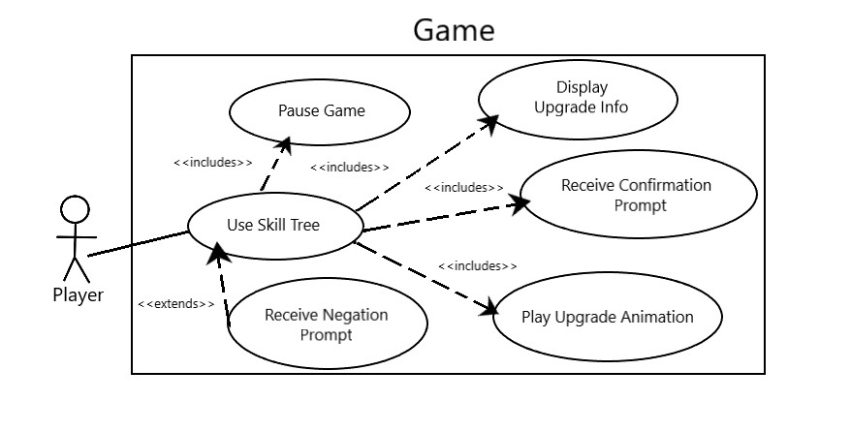
Skill Tree Use Case Diagram - Liam Mathews

Slide 33
Team Lead 4 - Nyah Nelson
Features - Inventory and UI

Slide 34
User Interface Overview
Role = The UI will be all the menus the user can access by clicking on buttons or pressing keys, and the HUD which will display inventory, the player profile, and pause button.
Priority = 1 (must have)
The user needs to have some sort of navigation to be able to play the game
Complexity = medium
Not nearly as difficult as other features, but it is an essential part and will have to be easily accessible to the user

Slide 35
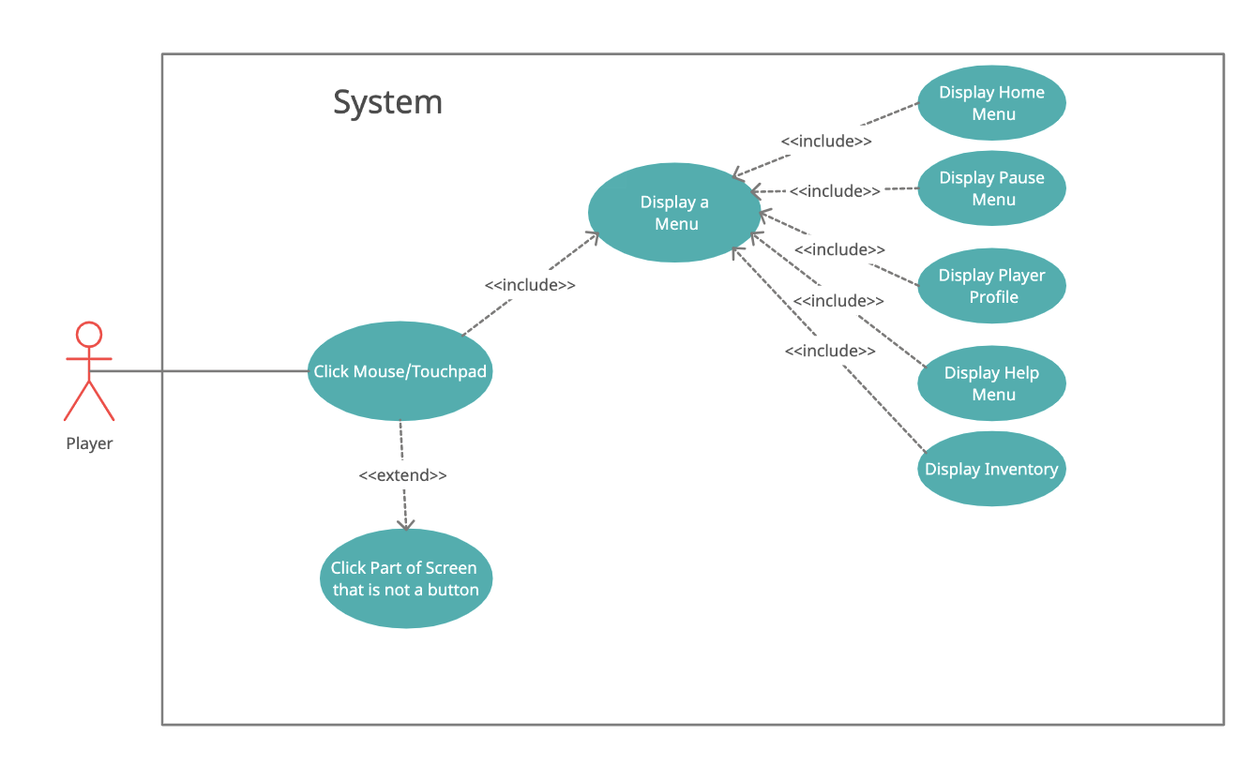
UI Use Case Diagram

Slide 36
Inventory Overview
Role = Inventory will be displayed in the HUD and will show the amount of each weapon, and will keep track of what weapons are available and can be used based on user input.
Priority = 2 (essential)
If weapons are used in the game, then there needs to be some kind of inventory to keep track
Complexity = medium
It won’t be super complex, but will be needed throughout the entirety of the game

Slide 37
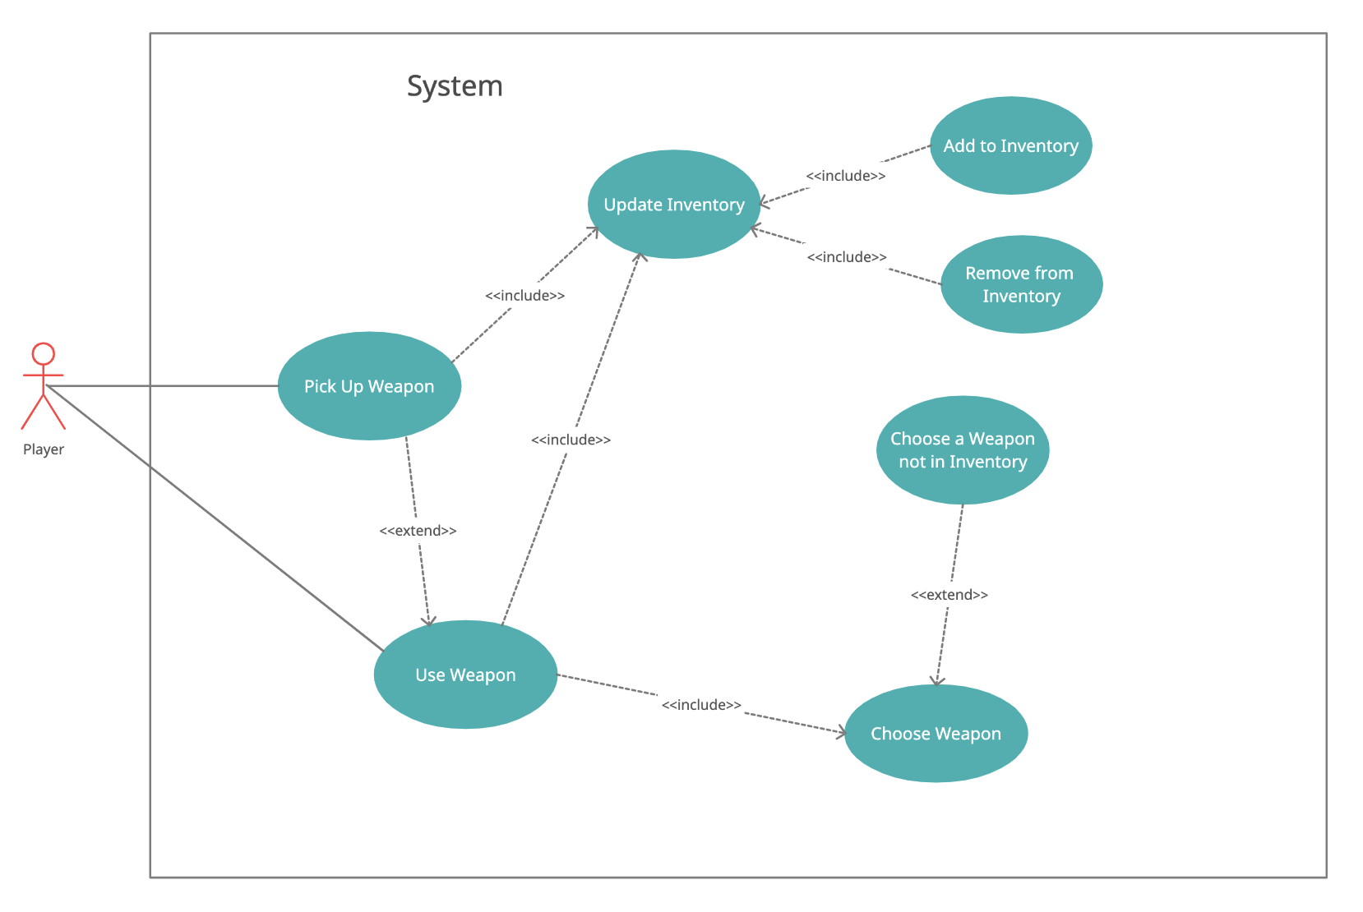
Inventory Use Case Diagram

Slide 38
Team Lead 5 - Jackson Baldwin
Features - Music Management and AI

Slide 39
Music Overview
Role = Music needs to be composed and implemented in the game. There will be main themes, boss themes, and SFX for picking up items, getting damaged, etc.
Priority = 3 (nice to have)
Music is not necessary, but it would be very boring without!
Complexity = low
This is a low level of complexity, and should be easy to implement. Will take a considerable amount of time

Slide 40
AI Overview
Role = Friendly AI…main job is the shopkeeper. Shopping is essential in a roguelike!
Priority = 2 (essential)
The game is playable without, but would have no way to upgrade items/heal
Complexity = medium
Understanding AI and setting up the shop will be somewhat tricky, not to mention other friendly AI throughout the game.

Slide 41
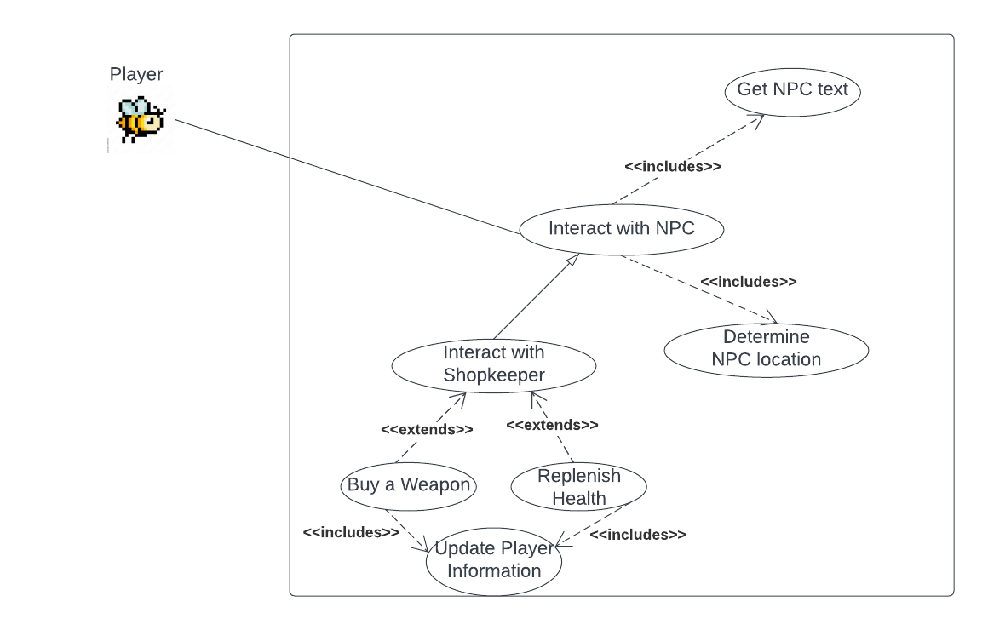
AI Use Case Diagram

Slide 42
Team Lead 6 - Bryan Frahm

Slide 43
Level Design Overview - Bryan Frahm
Role = The Level design will include the Level generator and the room prefabs that will randomly generate a world map and everything that inhabits it based upon player level.
Priority = 1 (must have)
A game needs a map in order to play, every object within the game will rely on my level/room generation.
Complexity = difficult
The game will heavily rely upon the level/room generation. There will need to be collaboration with every other team member to make sure that their features will be included within the world.

Slide 44
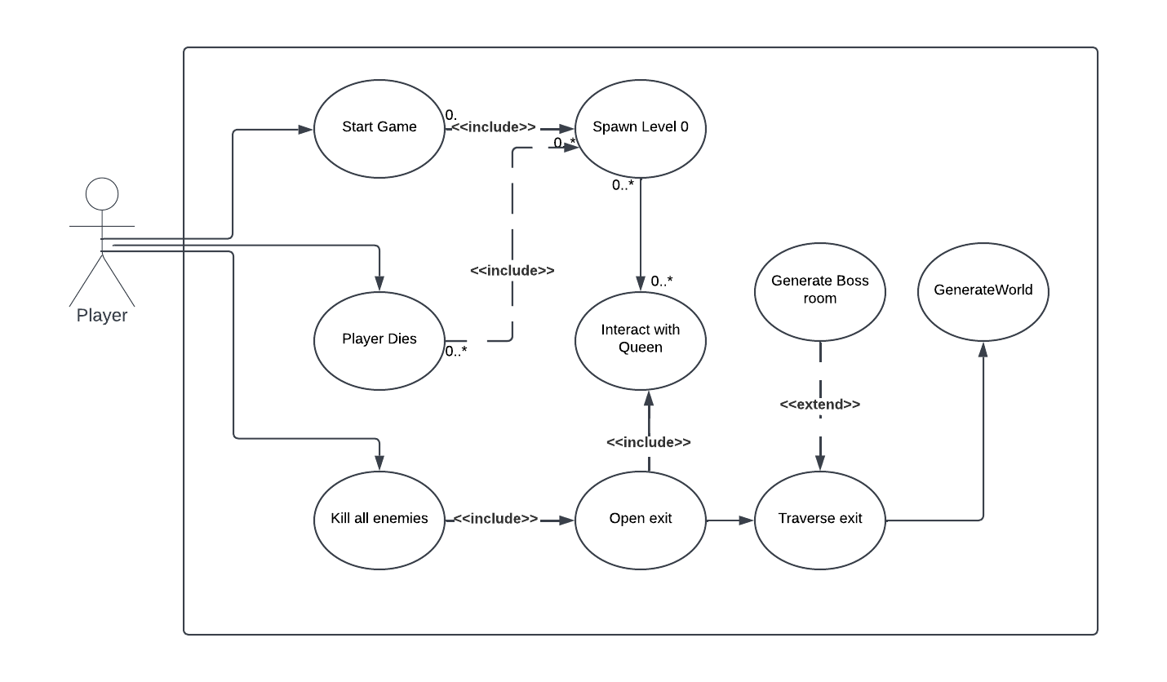
Generate Level Use Case Diagram - Bryan Frahm

Slide 45
Thank you!
Questions?

